Slide 1
Wavefront Control for High Performance Coronagraphy on Segmented and Centrally Obscured Telescopes
Presenter: Alexander Rodack
Mentor: Dr. Olivier Guyon
Colleagues and Advisors: Dr. Johanan Codona, Kelsey Miller, Justin Knight
Project Funded by NASA Grant NNX13AC86G
Saturday, 12 April, 2014

Slide 2
Outline
Introduction and Basic Terms
Research Goals/Methods
Current Progress
Next Steps
Future Application

Slide 3
What is Coronagraphy?
A coronagraph is a system to optically remove starlight from a science image
Originally used to study the corona of the Sun
Now being applied to directly imaging exoplanets
The most simple of all coronagraphs, your thumb

Slide 4
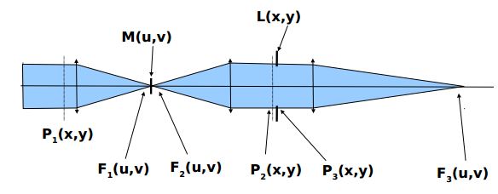
Types of Coronagraphs
The Fundamental:
The Lyot Coronagraph
The Lyot is the first coronagraph, to which optimizations were made to derive all the other types
The more Advanced:
Phase Induced Amplitude Apodization Coronagraph (PIAAC)
The PIAAC utilizes aspheric optics to remap the pupil of the system
The advantage of this approach is that it is lossless, and can be tuned to have a low inner working angle (IWA)

Slide 5
Notes on Exoplanets
Exoplanets are planets that orbit stars other than the Sun
To find other habitable worlds, direct imaging must be made possible
This is currently difficult because an earth-like planet around a Sun-like star has a contrast ratio of 10⁻¹⁰

Slide 6
Low Order Wavefront Sensing (LOWFS)

Slide 7
Science Goals for UA Testbed
High efficiency Wavefront Control
Necessary to meet requirements for cophasing mirror segments
LOWFS camera to drive wavefront control loop
Science camera acquires data at same speed as LOWFS camera to develop a ‘dictionary’ defining science Point Spread Function (PSF) response to wavefront aberrations
Use LOWFS to calibrate the Point-Spread Function (PSF)
Use measurements from WFS to estimate a long exposure PSF in the science camera image
Develop universal software package containing calibration algorithms

Slide 8
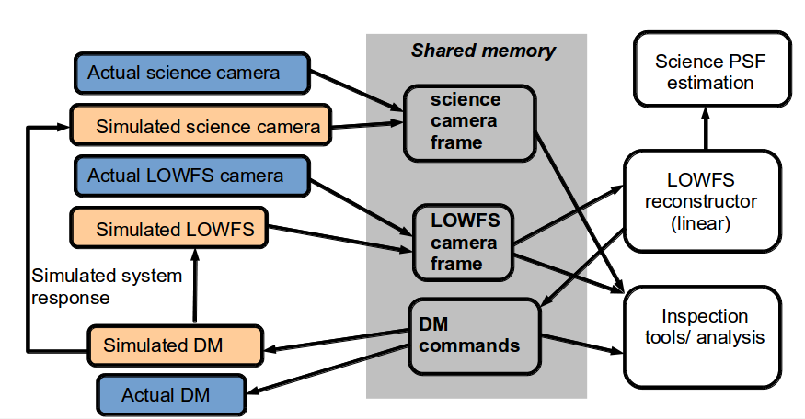
Universal Software Diagram
Development of universal software package will be applicable to other labs using similar hardware.
Includes other University labs and NASA labs
High Contrast Imaging Testbed (HCIT) at JPL
Allows for the Importing and exporting of ideas to and from other labs

Slide 9
Completed Work
Initial testbed setup and alignment
Mathematical model of Lyot coronagraph
Designed Lyot system for testbed implementation
Designed PIAAC system for testbed implementation
Devised computer system needed to run high speed cameras/deformable mirrors
Design of “laser safety box” (LSB) to contain supercontinuum source
class IV, 600 mW max output broadband source from ~400nm to ~2200nm, eye dangerous without attenuation

Slide 10
Lyot Coronagraph Matlab Simulation

Slide 11
Current System

Slide 12
Next Steps
Implementation of
Supercontinuum source and LSB
PIAA optics
Deformable Mirrors (DM)
Replace testing camera with high speed CMOS camera
Integrate coronagraph optics
Focal Plane Mask (FPM)
Lyot Stop
Add high speed LOWFS camera
Perform tests and write algorithm

Slide 13
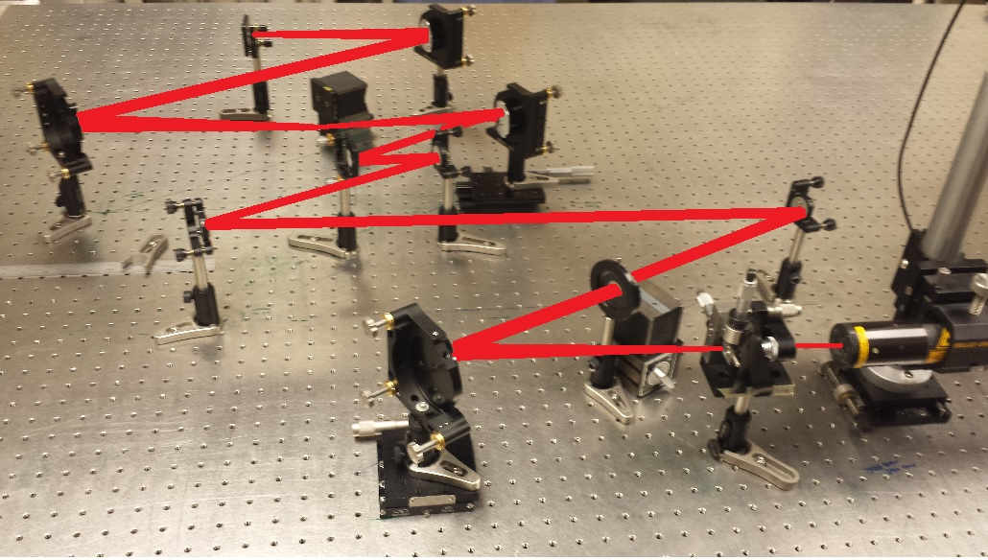
Next Steps
CMOS CAMERA
LOWFS CAMERA
LYOT
STOP
FPM
PIAA OPTICS
DM 2
DM 1
SUPER CONTINUUM SOURCE

Slide 14
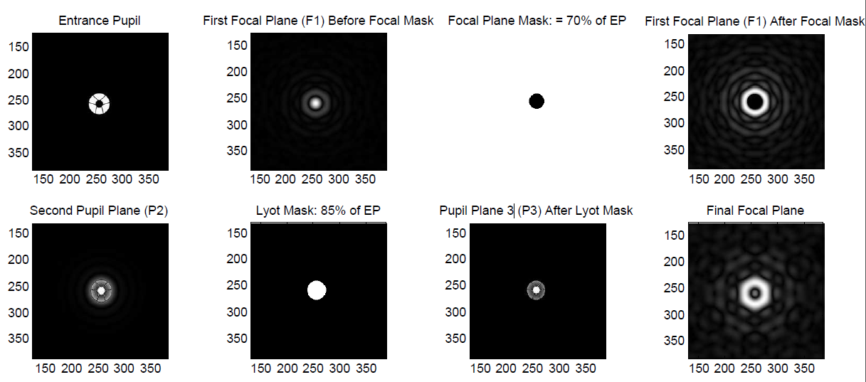
Application to Future NASA Missions
Will support near-term (WFIRST-AFTA) and longer term NASA missions to image and study exoplanets
Testbed is compatible with any pupil type by changing DMs.
Centrally-obscured
Segmented
Non-obscured
Matlab Models of other pupils are possible

Slide 15
Acknowledgements and Special Thanks
Dr. Olivier Guyon
Dr. Johanan Codona
Kelsey Miller
Justin Knight
Susan Brew
Leah Edwards

Slide 16
Thank You
Any Questions?

